Slide 1
COMMONWEALTH OF MASSACHUSETTS
Deval L. Patrick, Governor
Richard K. Sullivan, Jr., Secretary
Mark Sylvia, Commissioner
The Green Communities Division Partnering with Massachusetts
Cities and Towns
Seth Pickering
Southeast Regional Coordinator
Green Communities Division
Town of Chilmark
Board of Selectmen
Green Communities Presentation
September 18, 2012

Slide 2
Massachusetts
Cleaner energy is part of our future
Priorities of the Patrick Administration
● Green Communities Act
● Global Warming Solutions Act
● Green Jobs Act
The landmark Green Communities Act provides a strong foundation focusing on energy efficiency, investment in renewables and the creation of the Green Communities Division.

Slide 3
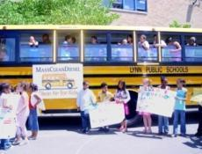
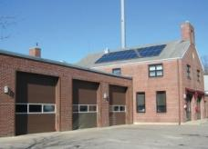
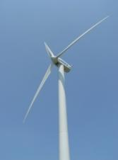
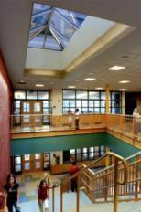
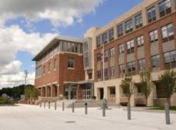
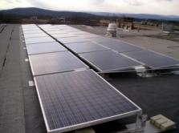
Serves as the hub for all Massachusetts cities and towns on energy matters
Green Communities Division

Slide 4
GOING GREEN, WHAT DOES IT MEAN?
Cities, towns and other local governmental bodies can reduce their energy costs by:
Establishing an Energy Committee / Designating an Energy Officer
Establishing an energy baseline for municipal buildings, schools, streetlights and all vehicles
Performing Energy Audits on municipal buildings
Implementing energy efficiency measures (e.g. town investments, utility rebates and incentives, grant programs and performance contracting)
Changing behaviors: (e.g. energy conservation policies)
Exploring renewable energy opportunities

Slide 5
Green Communities Division Programs & Resources
Programs/Resources for Municipalities
MassEnergyInsight System
Green Communities Grant Program
Municipal Energy Efficiency Program
Energy Performance Contracting Technical Assistance
Website @ http://www.mass.gov/eea/energy-utilities-clean-tech/green-communities/
Email updates via listserv – Sign up by sending an email to: join-ene-greencommunities@listserv.state.ma.us
Regional Coordinators

Slide 6
GREEN COMMUNITIES GRANT PROGRAM
Provides grants to qualifying communities to fund energy efficiency initiatives, renewable energy, innovative projects
Qualification Criteria
Adopt as-of-right siting, in designated locations, for RE/AE generation, or RE/AE R&D, or RE/AE manufacturing
Adopt expedited (12 month) application/permitting process
Establish an energy use baseline with a plan to reduce baseline by 20% in 5 years
Purchase only fuel-efficient vehicles
Require new residential construction and new commercial and industrial real estate construction to minimize life-cycle energy costs (Adopt Stretch Code - 780 CMR 115, Appendix AA)
http://www.mass.gov/eea/energy-utilities-clean-tech/green-communities/gc-grant-program/

Slide 7
Green Communities Designation and Grant Flowchart
Step 1
Review Green Communities Designation Criteria Guidance
Step 2
Discuss Green Communities Designation with Local Government
Step 3
Meet the 5 Green Communities Criteria and submit a Designation Application
Receive Green Community Designation from DOER
Contact your Green Communities Regional Coordinator
Apply for Green Community Grants
Receive local approval to apply for Green Communities status

Slide 8
Criteria 1 – As-Of-Right Siting
For at least one of the following:
Renewable or Alternative Energy Generating Facilities or;
Renewable or Alternative Energy Research and Development (R&D) Facilities or;
Renewable or Alternative Energy Manufacturing Facilities in designated locations.

Slide 9
Criteria 1 – As-Of-Right Siting / Generation
On-Shore Wind – A turbine of a minimum 600 kW in size or above
Off-Shore Wind – A turbine of a minimum 2.5 MW or above
Solar Photovoltaic – A single ground-mounted system of a minimum of 250 kW or above
Biomass CHP - A minimum of 5 MW in a stand-alone building
Ocean, Wave or Tidal – no minimum threshold

Slide 10
Criteria 2 – Expedited Permitting
12 months: date of initial application to date of final approval
Applies only to the proposed facilities subject to the as-of-right siting provision.
Can apply the MGL c 43D permitting process to these zoning districts

Slide 11
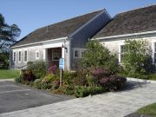
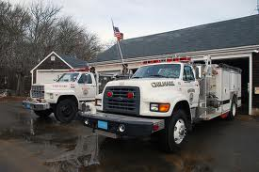
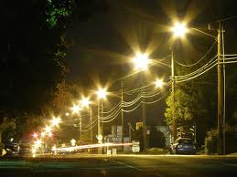
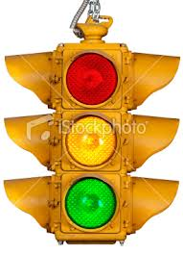
Criteria 3 – Energy Baseline & 20% Energy Reduction Plan
Calculate a Municipal Energy Use Baseline that includes:
Municipal Buildings & Schools
All Vehicles
Municipally Owned Street & Traffic Lights

Slide 12
Criteria 3 – Energy Tracking Tools
DOER’s MassEnergyInsight (www.massenergyinsight.net)
EnergyStar Portfolio Manager
ICLEI software
Any other tools must be pre-approved by DOER

Slide 13
Criteria 3 – Energy Baseline & 20% Energy Reduction Plan
Create a comprehensive energy reduction plan designed to reduce energy use by 20 percent within 5 years of the baseline year.

Slide 14
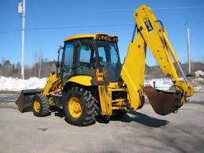
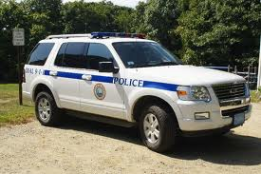
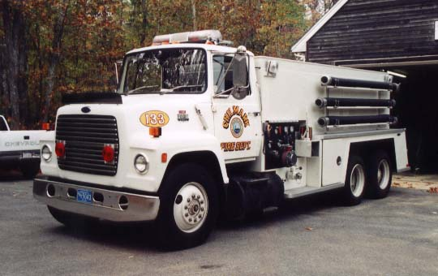
Criteria 4 – Fuel Efficient Vehicles
Purchase only fuel-efficient vehicles for municipal use whenever such vehicles are commercially available and practicable.
Police cruisers are exempt until
commercially available.
3. Heavy-duty vehicles > 8,500 pounds are exempt.

Slide 15
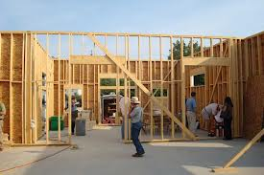
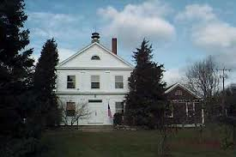
Criteria 5 – Minimize Life Cycle Costs
Require all new residential construction and all new commercial and industrial real estate construction to minimize, to the extent feasible, the life-cycle cost of the facility by utilizing energy efficiency, water conservation and other renewable or alternative energy technologies.
The DOER recommended way for cities and towns to meet this requirement is by adopting the BBRS Stretch Code (780 CMR 115.AA) an appendix to the MA State Building Code.
In a town, the Stretch Code must be adopted as a general bylaw by its Town Meeting.
In a city, the Stretch Code must be adopted by the City Council, preferably by general ordinance.

Slide 16
Meet the Green Communities!
Notes:
Next deadline June 10th!

Slide 17
Stretch Code Communities

Slide 18
Green Communities Designation and Grant Program – 103 Green Communities
Grant allocations based on a $125K base plus a population/per capita income formula; maximum $1M.
Town Grant Population
Bridgewater $200,800 25,185
Easton $168,829 22,299
Hanover $148,598 13,164
Kingston $163,528 11,780
Lakeville $158,275 10,602
Mashpee $170,124 14,006
Provincetown $143,600 2,964
Scituate $163,025 17,863
Tisbury $140,925 3,949
Truro $141,200 2,003
West Tisbury $143,250 2,740
18
Notes:
NEXT DEADLINE

Slide 19
Green Communities Designation and Grant Program – Hanover
Hanover - $148,598
Incremental Cost Increase to purchase a Chevrolet Tahoe Hybrid Police Department vehicle – Cost increase to purchase a hybrid vehicle, total vehicle cost was $57,438, amount GC Grant paid = $24,600.
Replace Steam Traps at Sylvester and Salmond Schools – Installation of new steam traps in school heating systems to improve system efficiency, $20,000.
Replace Town Hall Boiler – Upgrade to more efficient boiler at Town Hall, $30,000.
Replace Fire Station HQ Doors – Install new energy efficient rollup doors for fire engine bays at FD, $40,000.
19
Notes:
NEXT DEADLINE

Slide 20
Green Communities Designation and Grant Program – Kingston
Kingston – $163,528
Kingston Library - GC Grant = $47,920, NStar Incentives = $11,077.
Installation of a new High Efficiency Condensing Boiler
Installation of CO2 sensors and motion sensors for fresh air controls/demand control ventilation
Installation of a new Honeywell HVAC Control System and Reprogram existing HVAC Units
Kingston Elementary School - GC Grant = $67,376, NStar Incentives = $74,449.
Installation of Kitchen Hood Exhaust Controls
Energy Management System (EMS) Upgrade and Re-Commissioning
Installation of CO2 sensors and motion sensors for fresh air controls/demand control ventilation
Day Lighting Controls
Smith Lane Fire Station- GC Grant = $42,488, NStar Incentives = $5,294.
Installation of a new High Efficiency Condensing Boiler
Installation of a new High Efficiency 3 Ton AC Unit
Lighting and ballast replacements
20
Notes:
NEXT DEADLINE

Slide 21
Green Communities Designation and Grant Program – Easton
Easton - $168,829
Replace Town Office Boiler – Upgrade to 94% thermal efficient gas fired unit, $66,200. Payback = 9 years.
Replace Police/Fire Station Roof Top Heating/Cooling Unit – Upgrade to new high efficiency unit with high EER rating and exhaust air energy reclaim system, $85,000. Payback = 5 years.
Replace Water Division Garage Heaters – High efficiency infra-red units, $4,749. Payback = 1 year.
Middle School Energy Efficient Parking Lot Lights – Middle School parking lot, $3,500. Payback = 1 year.
High School Gym Lighting Upgrade – High efficiency lighting installed in High School Gym, $8,500. Payback = 2 years.
21
Notes:
NEXT DEADLINE

Slide 22
MUNICIPAL ENERGY EFFICIENCY
Municipal Energy Efficiency - A major focus of the Green Communities Division is collaborating with municipalities by coordinating energy assessments with utilities, identifying energy efficiency resources and opportunities and evaluating the benefits of implementing energy conservation measures.
Cape Light Compact – Audits/Rebates/Incentives
Three Year Energy Efficiency Plans
Investor owned electric and gas utilities (IOU) are required to provide all available energy efficiency (EE) and demand reduction resources that cost less than new energy supply.
Utilities will provide more robust rebates, incentives and programs to meet their goals.
Plans – IOUs to invest $2.2 billion in EE measures over 3 yrs.
For more information contact: Aimee Powelka Aimee.Powelka@state.ma.us or (617) 626-7356

Slide 23
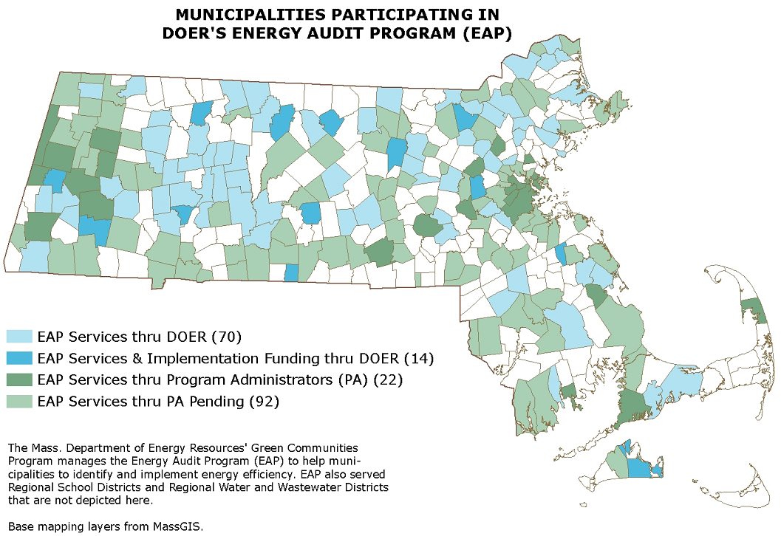
Municipal Energy Efficiency - EAP
Helping municipalities, school districts, water and waste water districts identify and implement energy efficiency measures
Notes:
DOER program, transitioned to utilities with facilitation by the Pas
GCA, utilities have significant goals they must meet for EE along with $$ to do so, municipalities provide opportunity
All in queue served by end of this calendar year

Slide 24
Energy Management Services Assistance – MGL c25A sections 11C and 11i
Also known as Energy Savings Performance Contracting
Provide a guide, model RFR/RFQ and model contract documents
Review bid documents & contracts
Educate and guide communities through the process
Contact: Eileen McHugh at eileen.mchugh@state.ma.us,
617-626-7305
Notes:
Approximately 50 municipal performance contracts
Approximately 90 municipalities in process, including four regional
Website has a wealth of information

Slide 25
FREE online tool for MA cities, towns, RSD & WTP
Provides:
Automated electronic download of utility data
All energy costs and accounts in one place
Standard and custom reporting
One tool to do it all:
Benchmark: track energy use by town, department or building
Identify: least efficient buildings for efficiency action
Measure and verify: energy use trends by building over time
Notes:
Inform decision making around energy, before can make any decisions, need data, need to know what you are consuming.
Online tool, available at now cost
Automatic download of IOU data, user-friendly
Looking toward creating a MA benchmark – how does my school compare to simlar schools?
Criteria 3 – establishing baseline

Slide 26
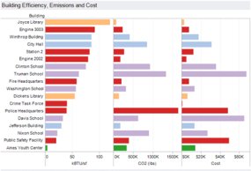
To date more than 425 individuals in more than 200 towns trained to use MassEnergyInsight to benchmark and monitor ongoing energy use, costs, and emissions
Notes:
More than half of all towns

Slide 27
Green Communities Contacts
Meg Lusardi – Director
meg.lusardi@state.ma.us (617) 626-7364
Seth Pickering – Regional Coordinator
seth.pickering@state.ma.us (508) 946-2838
Website: http://www.mass.gov/eea/energy-utilities-clean-tech/green-communities/

